Slide 1
Evolving IT at the Commonwealth
Aligning Business & Technology to Drive Positive Change
December 2, 2014
Bill Oates
Commonwealth Chief Information Officer

Slide 2
Agenda
  Building on Our Strong Foundation
  Moving the Commonwealth Forward
  A Few Recent Accomplishments
  Our Focus
  More Strategic Investments, Stronger Oversight
  Applying Best Practices Across the Commonwealth
  Paving the Way for Innovation & Collaboration
  Developing a Culture of Innovation
  The Municipal Opportunity
  Becoming Data Savvy
  Modernizing Our Approach to Recruiting
  Next Steps…

Slide 3

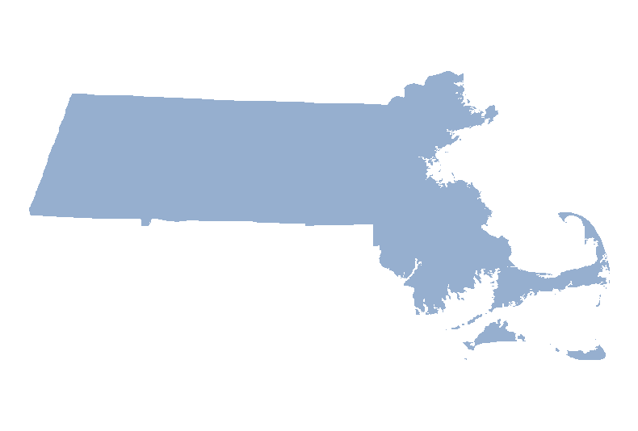
Building on Our Strong Foundation
  A new approach to aligning business and technology
  In response to challenges and unprecedented scrutiny,
  the Administration and Legislature took steps………………
  A new way of working together and providing services
  MassIT is now an activist IT organization
  Our job: build on the success of consolidation & recent reform
Baseline
Future
  60 Data centers 2 Data centers
  55 Desktop groups 8 Desktop groups
  43 Helpdesks 9 Helpdesks
  23 Email systems 1 Email system

Slide 4

Moving the Commonwealth Forward
Invest
  Make the best
  business decisions
Government
as
digital
business.
There are no IT projects.
Execute
  Ensure ongoing business & technology alignment
Protect
There are no IT projects.
  Sustain the value of our investments
  and integrity of our environment
Notes:
Invest:
Align business and IT to identify and initiate projects
Evaluate expected constituent impact and ROI
Execute:
Procure quickly, fairly, and efficiently
Implement with strong, steady oversight
Protect:
Ensure consistent financial and technological support
Continually work to ensure security of constituent and state information and systems

Slide 5
A Few Recent Accomplishments
Chief Operating Officer charged with 24x7 operational excellence | Project management oversight of 2014 phase of HIX
Prioritized small projects with fast deliverables, leveraging emerging tech and Agile methodology | Increased oversight of major initiatives: RMV modernization, MassTax2, UI Online
Expanded legal support for procurement and contract management | Focused on ROI and likelihood of success for allocation of capital IT funds
Embraced innovation with GIO role folded into MassIT | Launched first Innovation Fellows Program
Created Office of Municipal & School Technology. We now offer affordable broadband connectivity to municipalities and e-Rate services to schools. | Created leadership role to champion partnerships that bridge the inside/outside government gap

Slide 6
More Strategic Investments, Stronger Oversight
  Rigorous business case discipline for IT initiatives
  Evaluate proposals against investment grade benchmarks;
  likelihood of success; and expected ROI and constituent impact
  We’re better at articulating benefits, estimating costs, & picking right projects
  Results: better oversight, shorter projects, faster return
  Strategic project assistance
  Proactive involvement in major projects, including RMV, UI Online, MassTax2
  Major project intercession; now proceeding with a more Agile approach
  Improved project oversight capability
  IT Portfolio Oversight Committee
  New Enterprise Project Management Office – focused first on HIX
Notes:
CASE tool in place; automates creation of business case for proposed projects. Used to develop FY15 capital plan and for ongoing project health checks

Slide 7
Applying Best Practices
  Institutionalizing lessons learned…
  From Department of Children & Families:
    Importance of enterprise mobility – and how to do it well
  From Health Connector:
    Need for enterprise-wide project management function
      New Enterprise Project Management Office (EPMO) under development
      To be used for Commonwealth projects going forward
  From recent project intercession:
    Step into project path – quickly assess & course correct
Notes:
DCF - Experience gained implementing mobile device management, enterprise-wide policies around mobility, and security for mobile. Close working relationship with HHS.
HIX - Assessment of all Secretariat project management offices; design of new EPMO

Slide 8

Paving the Way for Innovation & Collaboration
  Embracing opportunities for tech-enabled change…
  Creating path to cloud, mobility, social media, & data
  Bridging the inside / outside government gap

Slide 9


Developing a Culture of Innovation
  Simple goal: Deliver value – faster
  At workforce and project levels
  Implement high value pilots – focus on the citizen experience
  Build critical mass around innovation
  First class of Innovation Fellows at work
  Each has an impressive background in focus area
    They quickly have an impact in their area of expertise
    We get targeted help to meet pressing business needs

Slide 10
Driving Innovation – Six in Six
Six in Six (Plus One) Projects
1. | Centralized system & mobile app for Public Housing
2. | Pilot of centralized database for homeless clients
3. | Pilot leveraging data visualization with GIS
4. | Creation of Rapid Apps team/approach
5. | Innovative Procurement Competition
6. | Lower-cost broadband for K-12 in western MA
7. | Free public wifi – starting in Gateway Cities

Slide 11


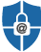




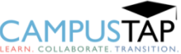
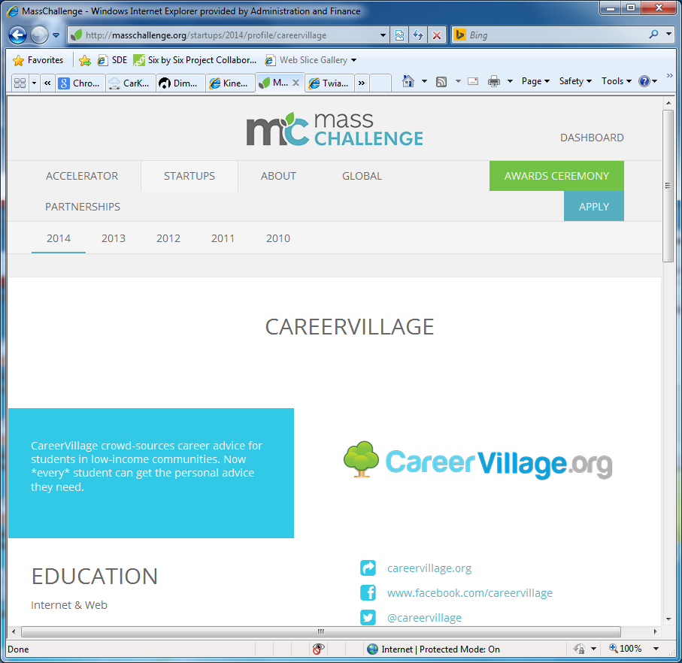

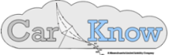

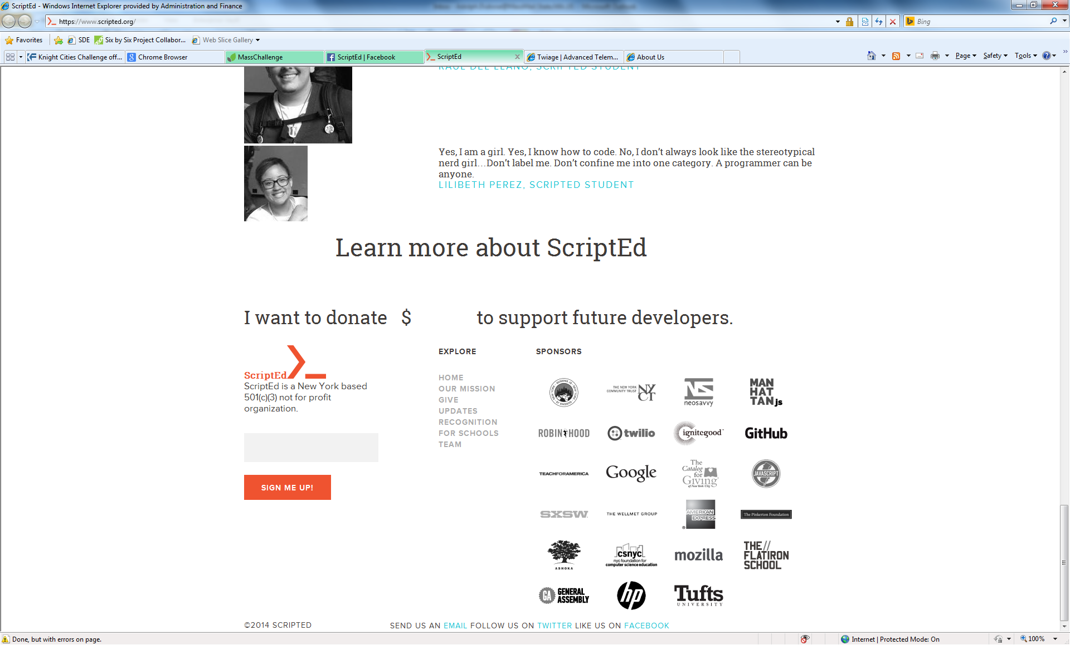




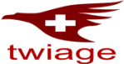


MassIT Government Innovation Competition – 21 Applicants!
 | Team Name | Description
 | Amida Technology Solutions | Consolidates medical records
 | Astra IDentity, Inc. | Email security
 | Cabinet | Constituent management
 | CampusTap | Recruiting (HR)
 | CareerVillage.org | Recruiting (HR)
 | CarKnow LLC | Transportation and logistics
 | Dimples, Inc. | Ink conservation
 | EdTrips | School field trips
 | Hablando con Julis | Accessibility
 | Jenyta Market | Digital workflow
 | Team Name | Description
 | Kinems Learning Games | ADHD education
 | Lig | Constitute legal empowerment
 | MyndLift | Accessibility and education
 | OpportunitySpace | Gov’t space efficiency
 | PetSimpl | Pet tracker
 | Reserve-a-Game | Parks and recreation
 | ScriptEd, Inc. | Code education for poor
 | SitterCycle.com | Childcare training
 | Tavana LLC | Bike safety
 | Twiage | EMS
 | VoiceItt | Accessibility

Slide 12

Notes:
Image above is hyperlinked to MassIT / MassChallenge video on YouTube at: https://www.youtube.com/watch?v=rER0RojWSgw

Slide 13
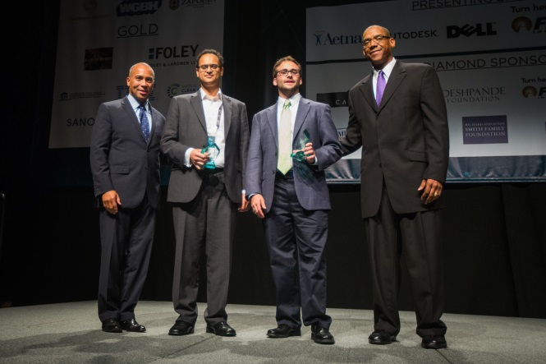
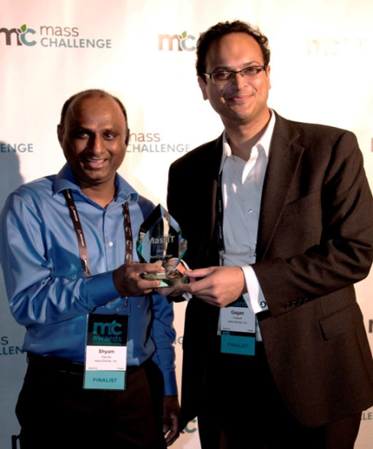
Our Winners
AstraIDentity, Governor Patrick, CarKnow, & GIO Tony Parham
at the MassChallenge Awards Ceremony
AstraIDentity

Slide 14
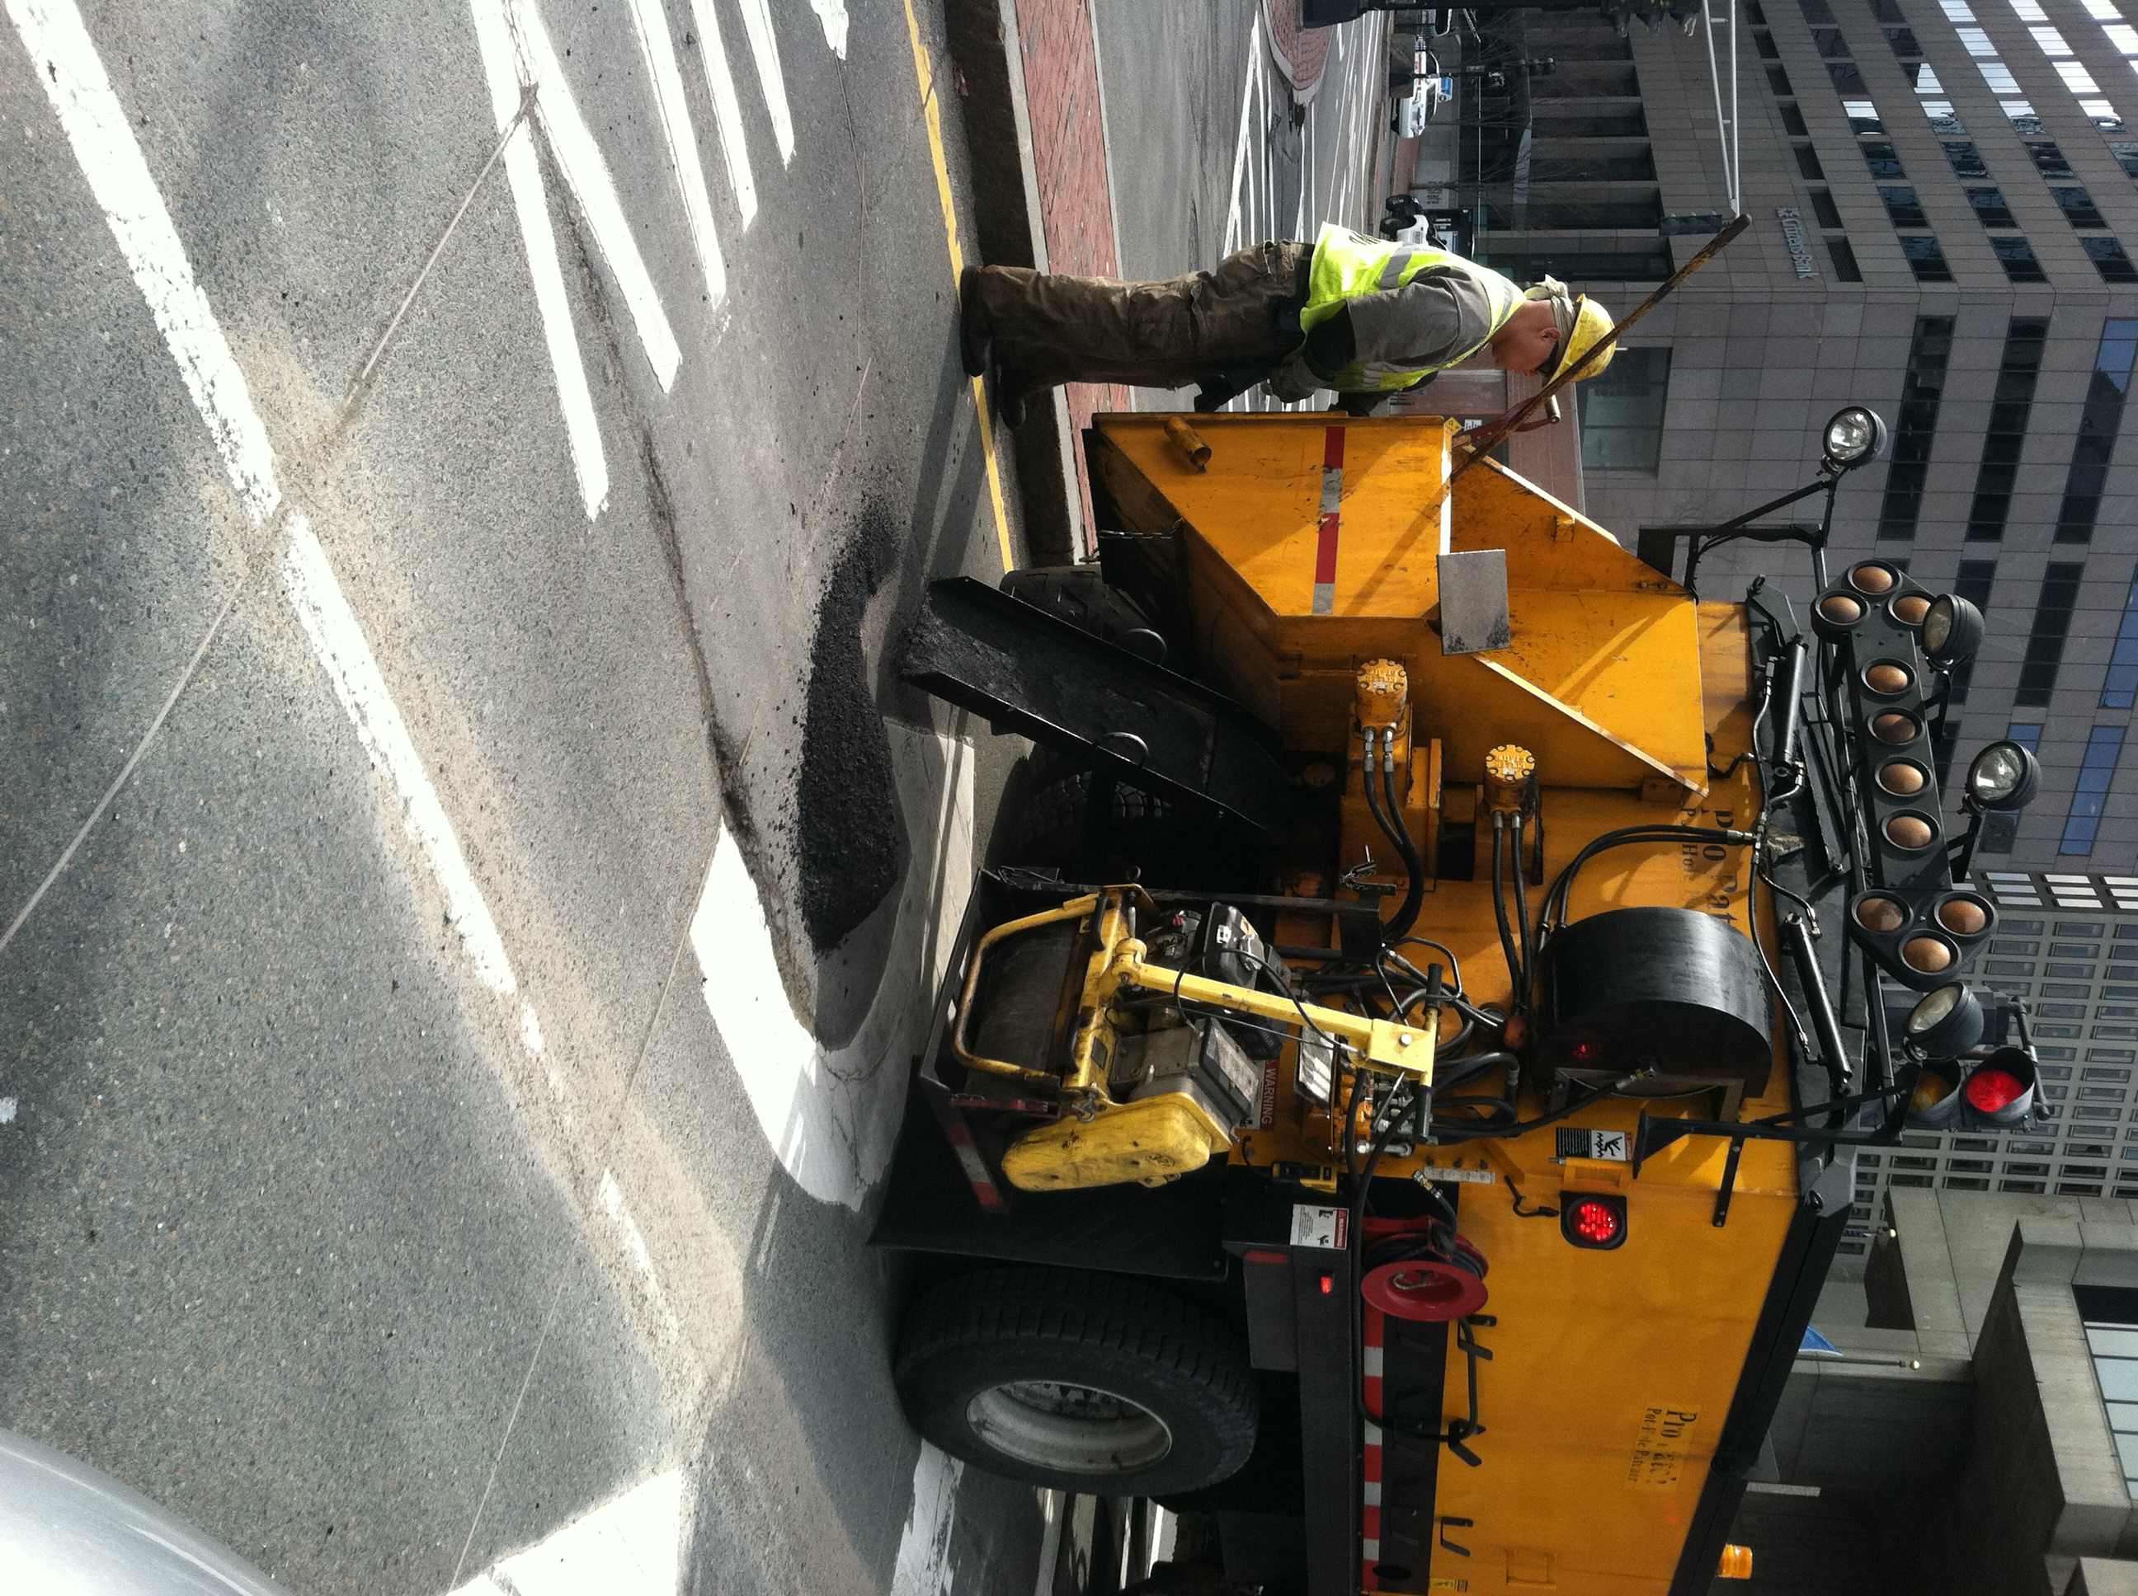

The Municipal Opportunity
  More than outreach – solutions.
  What we are working on:
  IT to improve local services & effectiveness
  Better connectivity, infrastructure, & applications
  Enhancing technology for schools
  How we will get it done:
  Deputy Commonwealth CIO
  Office of Municipal & School Tech
  IT bond bill, with state education agencies
  Community Innovation Challenge Grants and partnerships
Notes:
We are taking our new activist role to the streets. Or at least, to the cities and towns of the Commonwealth. ;)
And in addition to our long-standing partnership with MBI, we are now actively engaging with the MassTech Collaborative, the Mass Tech Leadership Council, regional planning councils, academia, and the private sector.
We are building on the work that ITD started a couple years ago with a liaison to municipalities…
For the first time, we have a team of people focusing on supporting and meeting the technology needs of municipalities.
Our Deputy Commonwealth CIO, Karthik Viswanathan, is leading this team – called the Office of Municipal & School Technology .
The creation of this team dramatically increases our capacity to work with and support municipalities.
They are on the front line of connecting us at the state with our counterparts in cities and towns.
And they are already building on existing relationships and offerings to help serve communities in a meaningful way.
This summer, the state legislature passed a billion-dollar IT bond bill to support critical technology investments over the coming three years.
A key element of that bond bill is that $38 million dollars are dedicated to enhancing technology in schools.
Our team will be working directly with our state education folks and school districts to make that happen.

Slide 15
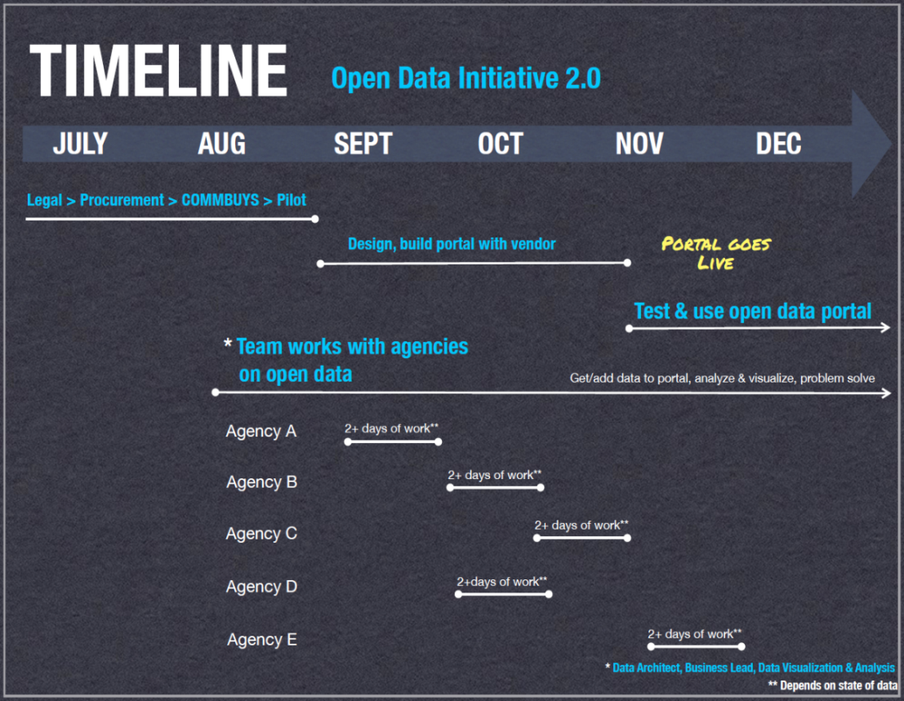
Becoming Data Savvy
  Leverage the data deluge.
  Transform data…
  into meaningful information
  Drive culture shift from
  “need to know” to
  “responsibility to share”
  Looking ahead, plan for data from other systems…
  Social media: sentiment analysis and trends
  Sensors: the Internet of Things
Notes:
Use meaningful information to…
Continually enhance services
Measure effectiveness of policies & services, and inform future direction

Slide 16
Performance Management = Data-Driven Decision-Making
Putting our data to work…
Analyze data to identify patterns, trends, outliers and gaps
Draw conclusions to identify root causes and actionable steps
Use analysis to make management decisions - modify policies and programs to achieve desired results
Communicate performance internally and externally
Student Outcomes
 | Prior | Current | Progress
Third grade reading proficiency | 68.1% (2012-13) | 70.0% (2013-14)
Student academic growth, grades 3-8 | 14.4% (2012-13) | 14.3% (2013-14)
ACT college readiness benchmarks | 18.1% (2012-13) | 20.0% (2013-14)
From State of Michigan Education dashboard

Slide 17
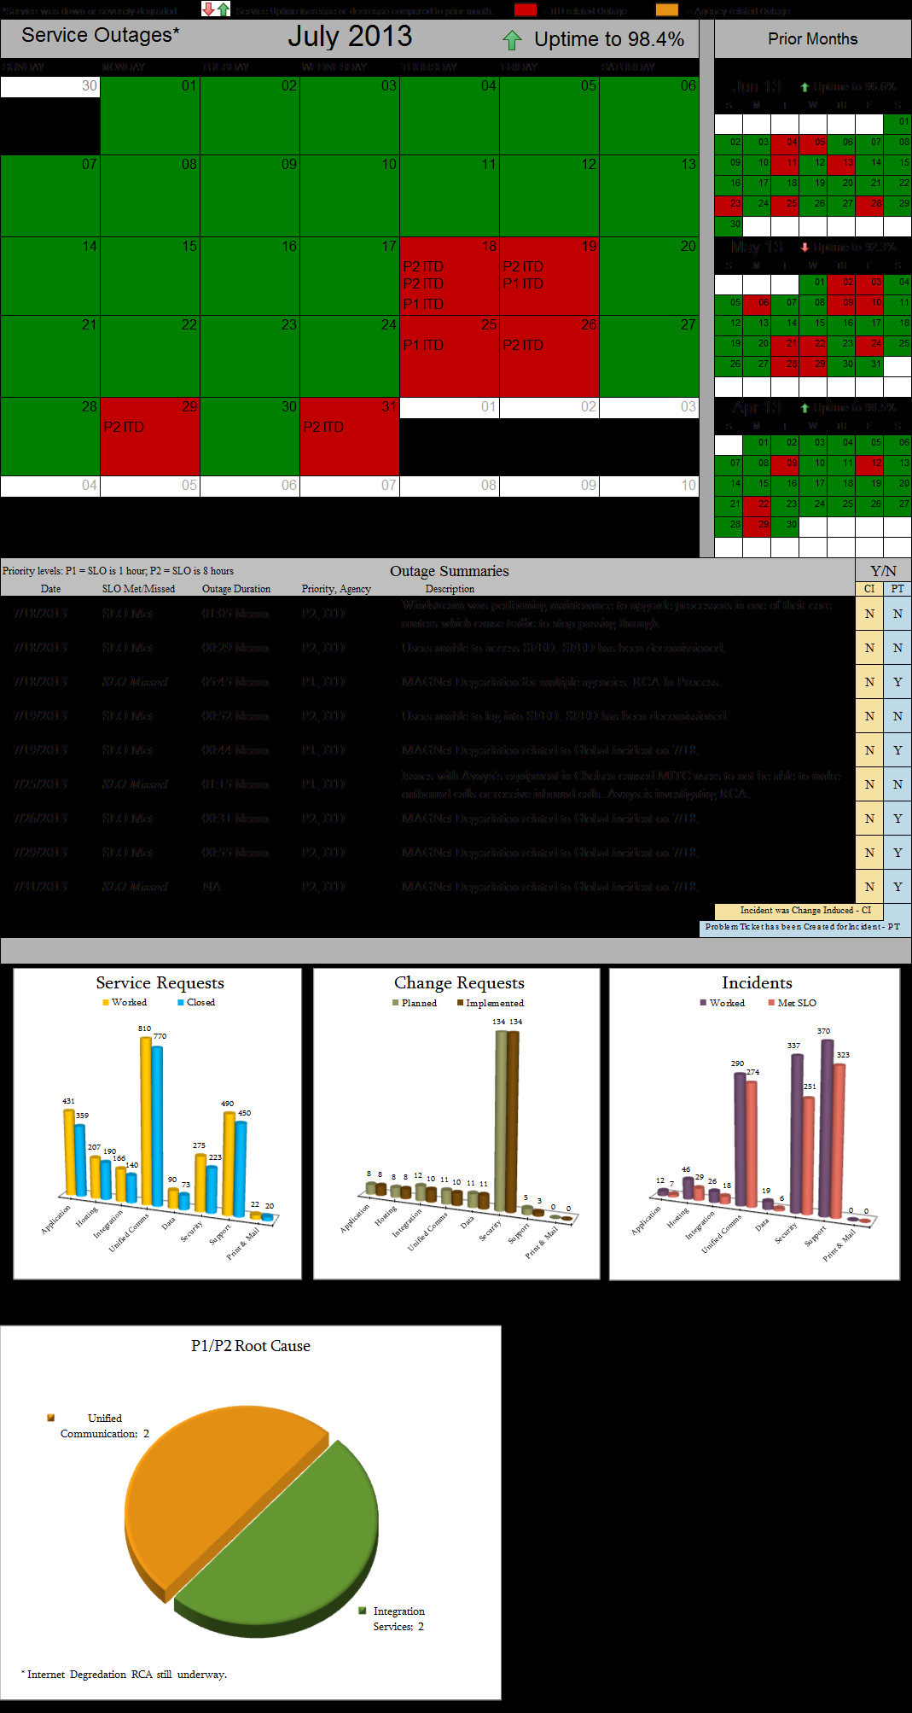
Measuring Technology Value-Add
From operational metrics…
to business value metrics
Decreased cost of agency service provision
Increased customer satisfaction
Decreased customer wait time
Decreased “time to market” for new applications

Slide 18

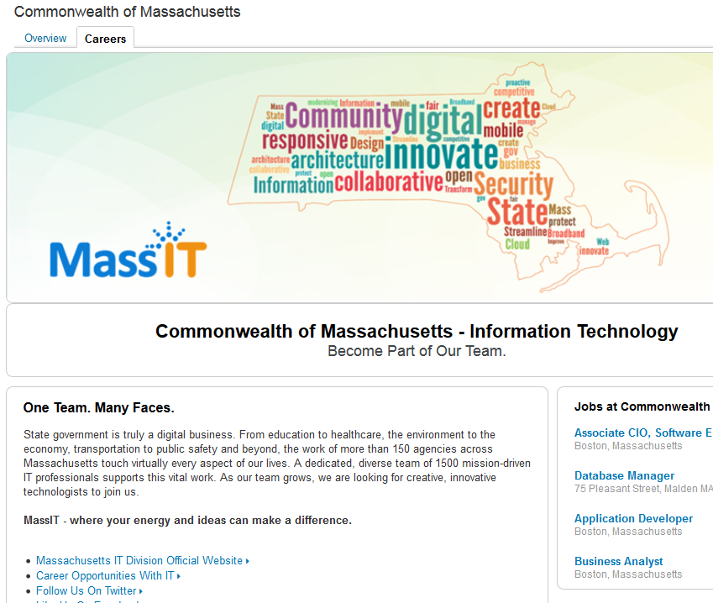

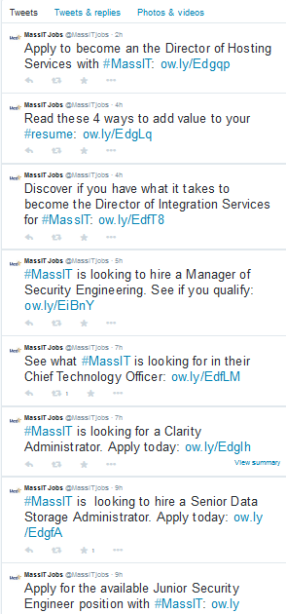
Modernizing Our Approach to Recruiting

Slide 19

Our Next Steps…
Together, foster a culture of innovation & collaboration.
Continue to drive excellence in project management.
Collaborate productively across boundaries.
Deliver value to the Commonwealth.
Notes:
In closing…
I am pleased to say that I am optimistic about what we can achieve when we work together.
By collaborating at the state and local levels, and across public and private entities, we can better serve residents and support business across the Commonwealth.

Slide 20
Thank You
Bill.Oates@Mass.gov
www.Mass.gov/MassIT

